Slide 1

Ai Mo A Primary School
English 5.
Teacher of english :
Hoàng Thị Hồng.

Slide 2


Ckecking up:

Slide 3



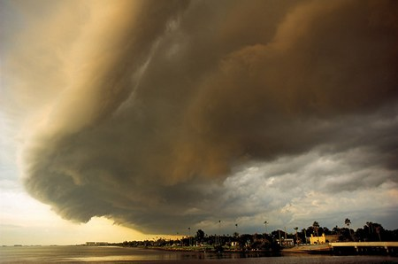

Bac Ninh
Hai Phong
Hue
Ho Chi Minh City

Slide 4
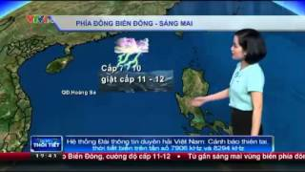
weather forecast

Slide 5
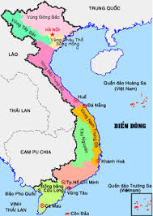
north
central
south

Slide 6
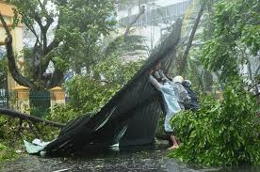
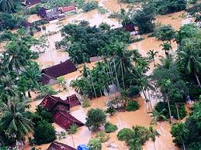
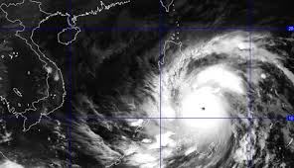
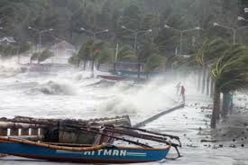
stormy

Slide 7
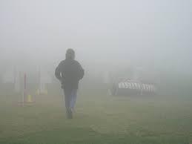
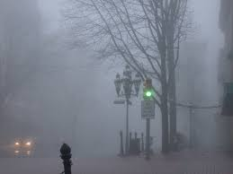
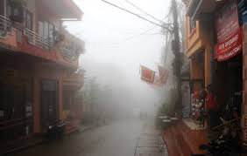
foggy

Slide 8



humid

Slide 9

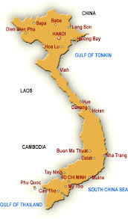
1.south
2.north
3.central
a.
b.
c.
d.
e.
4.stormy
5.foggy
6.humid
f.

Slide 10
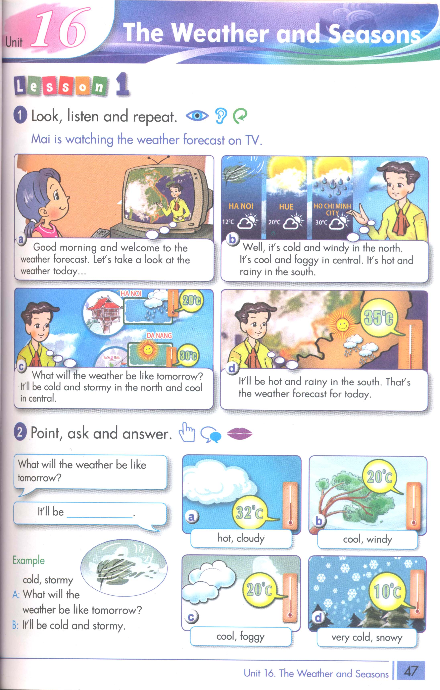


Slide 12


4.listening:
What will the weather be like tomorrow?
It’ll be cold and stormy.
Dùng để hỏi : thời tiết ngày mai sẽ như thế nào? Và câu trả lời.

Slide 14

4.listening:
Viet Nam | Today Tomorrow
The north | cold and _____ ____ and rainy
Central | _____ and foggy cold and ____
The south | humid and ____ ___ and stormy
windy
cold
cool
foggy
rainy
cool

Slide 15
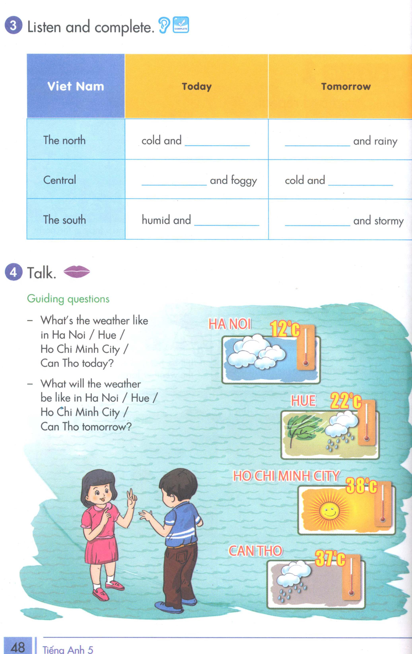

Slide 17






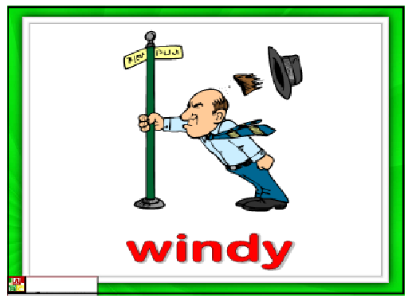

Slide 18


Homework.
Common European Framework reference- CEFR.

Slide 19









Nghia Dao Primary School
THANK YOU
FOR YOUR ATTENTION
Goodbye !
Notes:
19

Slide 20

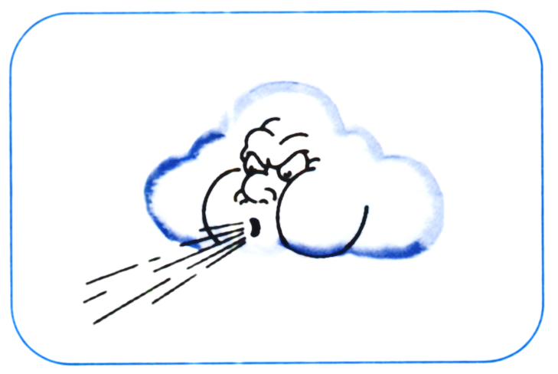



Ho Chi Minh City
Bac Ninh
Hai Phong
Hue

